Slide 1
Writing a Mobile App

Slide 2
Overview
App Development approaches
What is Xamarin?
Xamarin.iOS
Xamarin.Android
Xamarin.Forms
Layout Options

Slide 3










Slide 4
JavaScript
ActionScript
CSS
HTML
Black Box Approach

Slide 5

C# Code

Slide 6
What is Xamarin?
Xamarin offers a single language – C#, class library, and runtime that works across all three mobile platforms of iOS, Android, and Windows Phone (Windows Phone’s native language is already C#), while still compiling native (non-interpreted) applications that are performant enough even for demanding games.

Slide 7
Xamarin.Android & Xamarin.iOS
Xamarin.Android & Xamarin.iOS makes it possible for you to create native Android & iOS applications using the same UI controls as you would use in Java/Objective-C, but with the flexibility and elegance of C#, the power of the .NET Base Class Library (BCL), and Visual Studio at your fingertips.

Slide 8
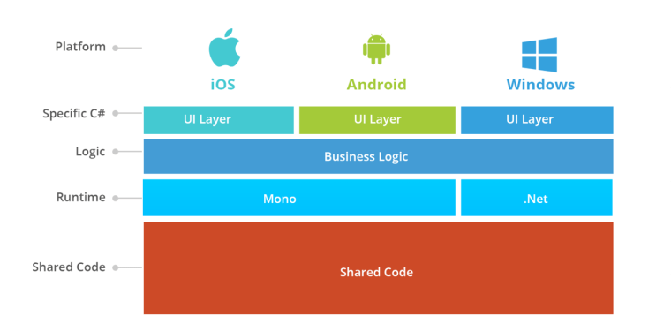
Source: https://www.nexlesoft.com/wp-content/uploads/2017/10/software-app-development.png

Slide 9
Xamarin.Forms
Xamarin.Forms is a cross-platform UI toolkit that allows developers to efficiently create native user interface layouts that can be shared across iOS, Android, Windows Phone, and Universal Windows Platform apps.

Slide 10
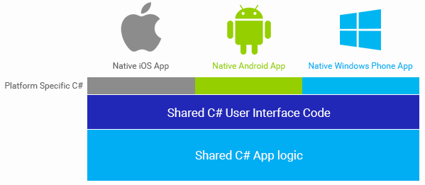

Slide 11
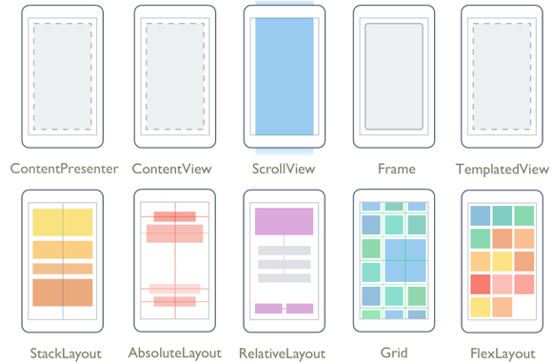
Source:https://docs.microsoft.com/en-us/xamarin/xamarin-forms/user-interface/controls/layouts-images/layouts.png

Slide 12
Want to learn More? Check these links out
Microsoft Learn Portal
https://docs.microsoft.com/en-us/learn/browse/?products=xamarin
Official DotNet Portal
https://dotnet.microsoft.com/learn/xamarin
Xamarin Official Docs
https://docs.microsoft.com/en-us/xamarin/

